Slide 1



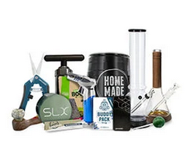



Web Testing

Slide 2










Site Description
| Legal shop
| Europe shop
| Delivery 4-7 days
| 100% PRIVACY

Slide 3
Positive and Negative
Register the Bugs
Smoke Testing
Compatibility Testing
Performance Testing
Testing
Aproach
Test Raport Test Data Set
Visual UI Testing
Exploratory
Testing
Security Testing

Slide 4





Tools Used

Slide 5









Testing
Types

Slide 6
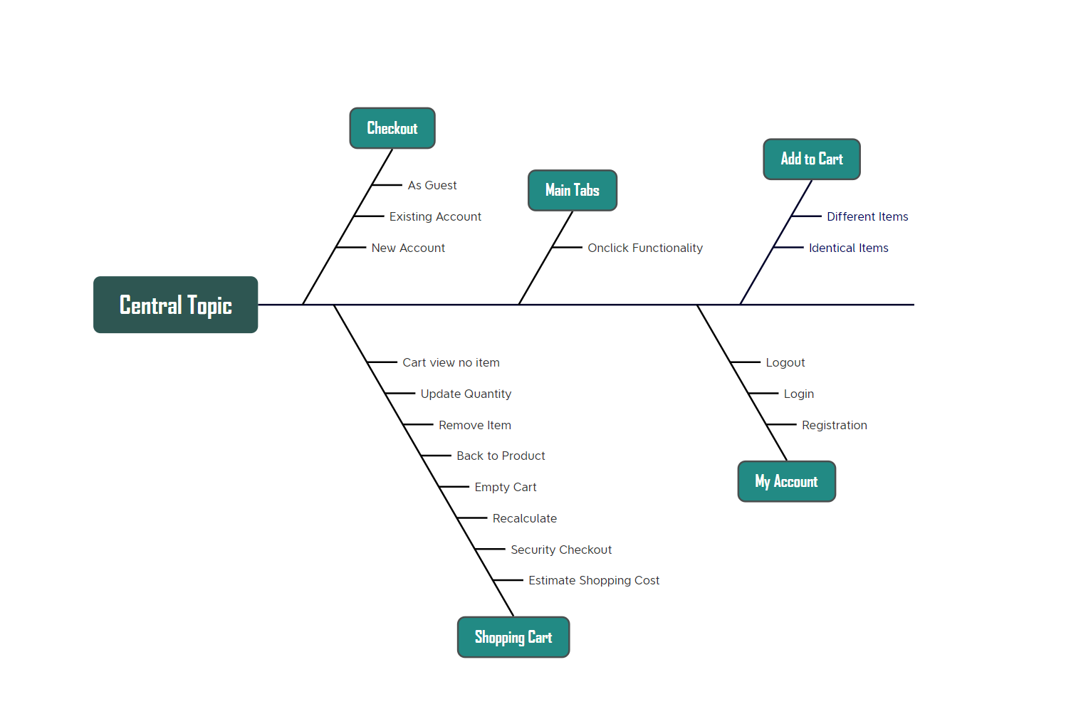
Test Cases Overview

Slide 7
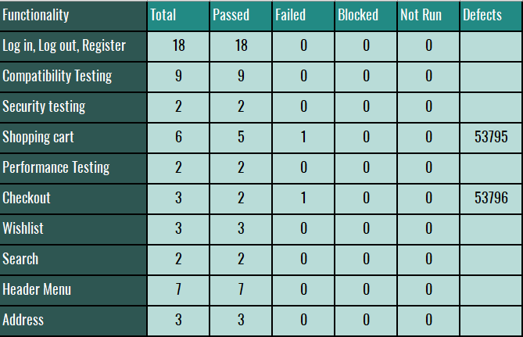
Test Cases Results

Slide 8
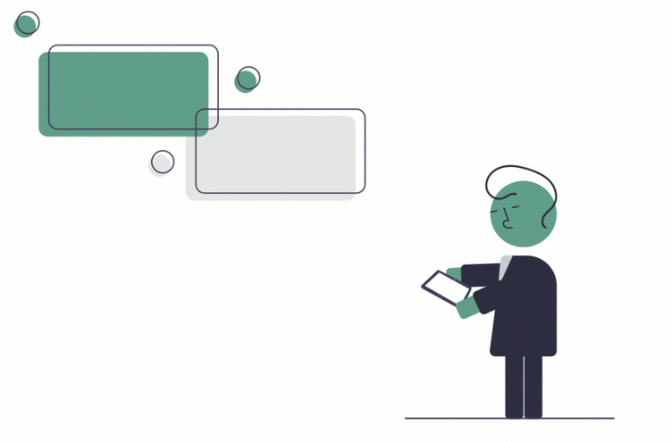
Conclusions
Zamnesia is a very good site, with very few bugs.
I executed 55 test cases and found only 2 bugs.
It is clear that Zamnesia has a good team.

Slide 9

LESSONS LEARNED
I learned how to do the work in the tools as efficiently and quickly as possible
I have a better understanding of the types of testing
I learned to think several times before doing something

Slide 10
Thank you for your attention
Q/A

